Slide 1

PUMP IT UP! Business Analytics With SAS – Group 09
Akshara Kumar
Don Rudin
Madhumitha Rajavel
Rohini Reddy
Vignesh Danasekaran

Slide 2
OVERVIEW
Business Problem
Data Description
Data Pre-processing
SAS Model
Analysis and Inferences
Business Value

Slide 3
BUSINESS PROBLEM
The most important source of survival for any living being on this planet is water
Tanzania, the largest country in East Africa with a population of over 52 million people
Our main aim is to check the functionality of water pumps in Tanzania for which the dataset have been collected. We would provide the following information after analyzing the data
The functional status of the pump
Factors affecting the functionality of water pumps

Slide 4
USES OF THE ANALYSIS RESULTS
It can help the Water Ministry of Tanzania to decide on which areas have the most functional failures and fix them to provide people with water.
Helps the locals to identify the nearest functional water pump
If proven that most of the pumps are not in a proper functional condition, social activists can come forward to help and assist maintain these pumps effectively
Welfare societies and organizations who are willing to invest can use this data to determine where they can effectively use their funds to create the most impact

Slide 5
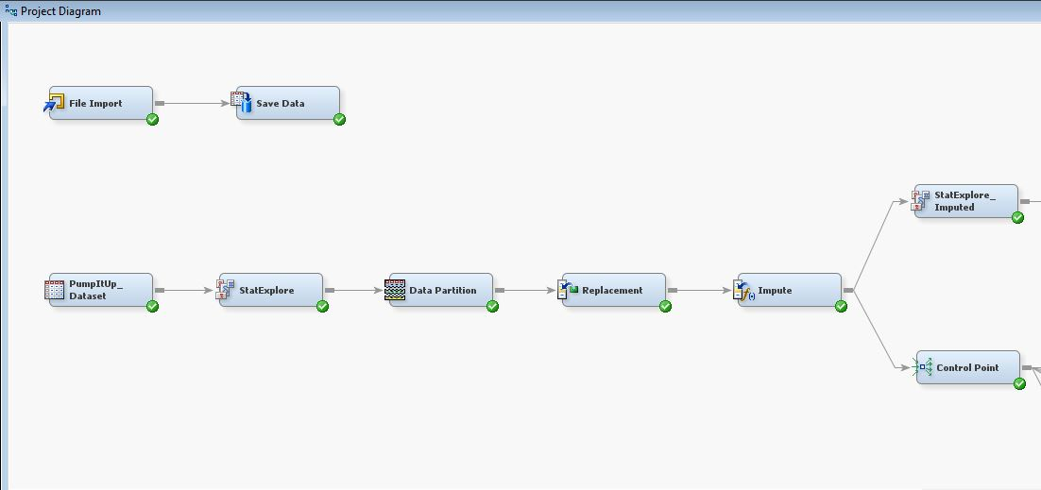
PROJECT DIAGRAM

Slide 6
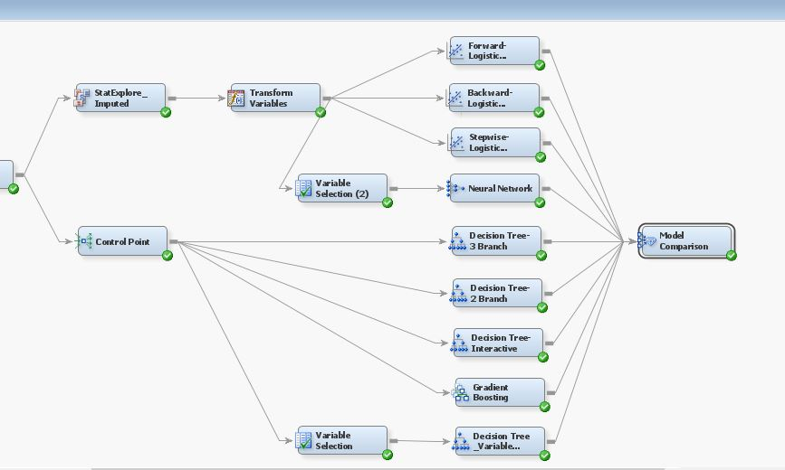
PROJECT DIAGRAM

Slide 7
DATA DESCRIPTION
In our project we use second- hand data obtained from Drivendata.
The data was collected by the Taarifa and the Tanzanian Ministry of Water.
This dataset consists of 59400 observations across 41 attributes.
Variable Type | Number
ID | 1
Input Variable/ Predictive Variable | 39
Target Variable | 1

Slide 8
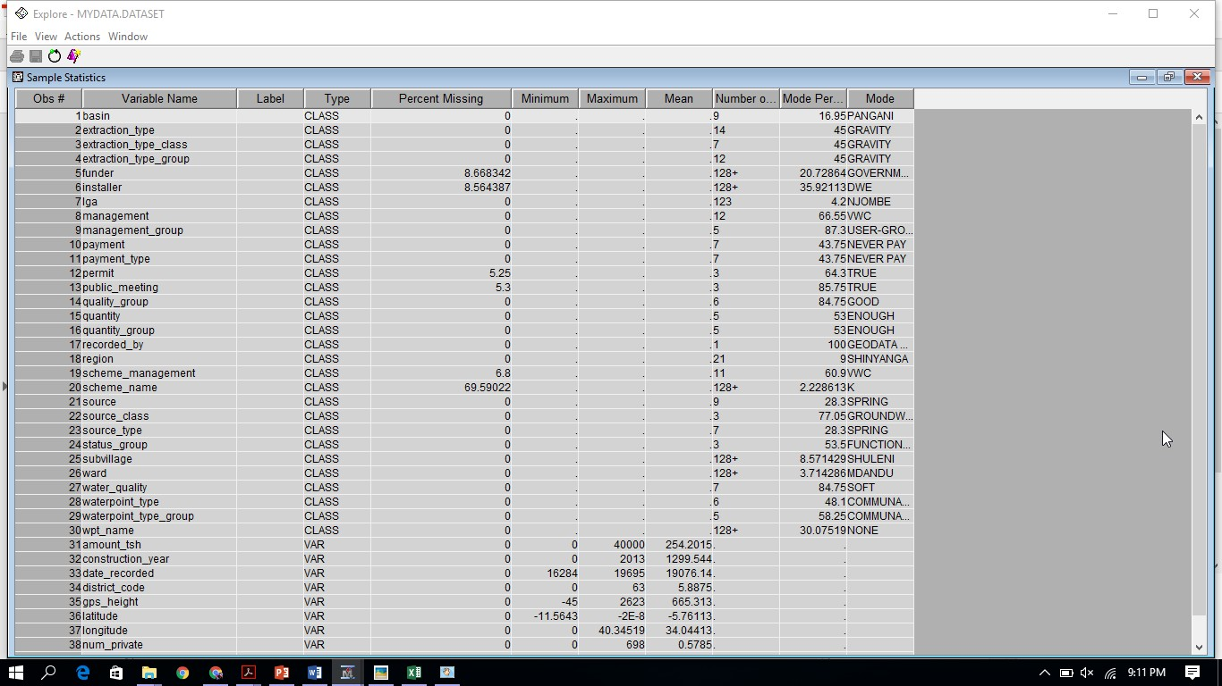
DATA DESCRIPTION - CONT’D

Slide 9
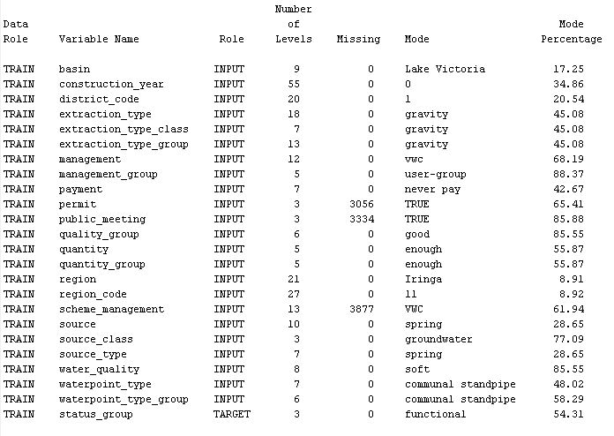
PRE-PROCESSING – STAT EXPLORE

Slide 10
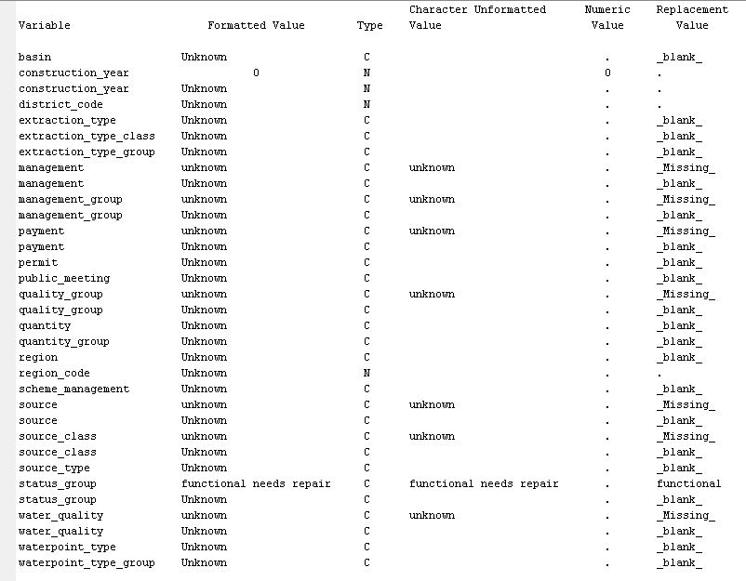
PRE-PROCESSING - REPLACEMENT

Slide 11
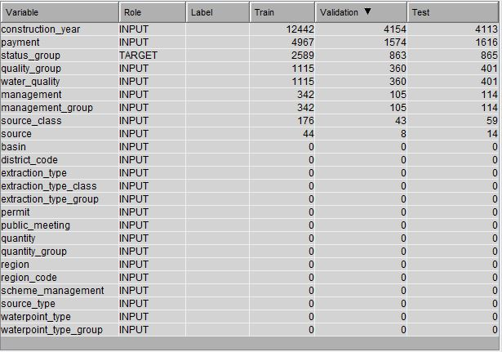
PRE-PROCESSING - REPLACEMENT

Slide 12
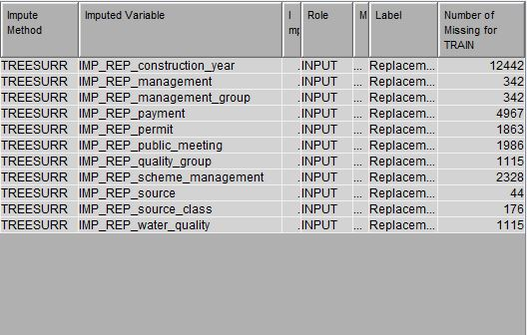
PRE-PROCESSING - IMPUTE

Slide 13
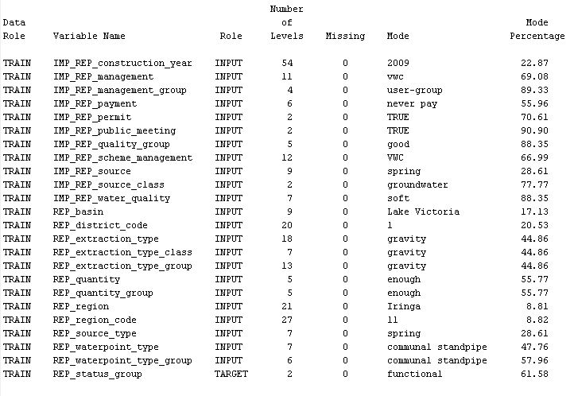
PRE-PROCESSING – STAT EXPLORE

Slide 14
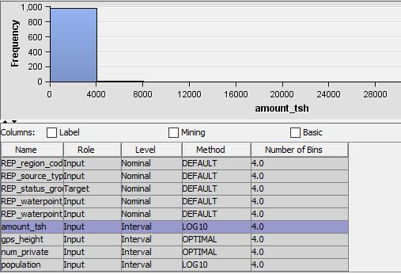
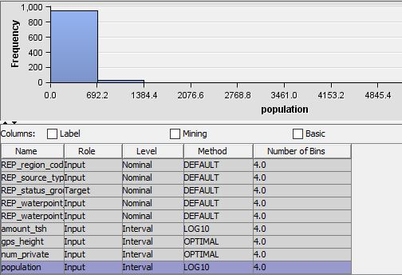
TRANSFORM VARIABLES

Slide 15
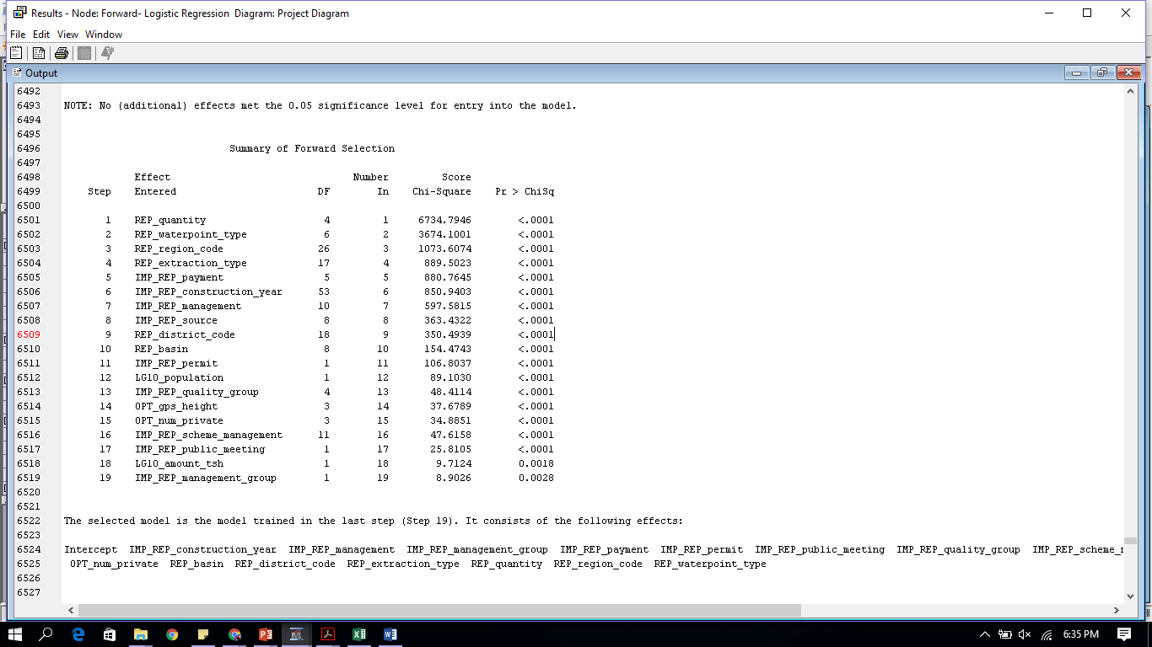
FORWARD LOGISTIC REGRESSION
This technique starts with just one effect and then sequentially adds the variables that improves the significance of the model
A series of 19 steps are followed
The selected model is the model trained in the last step (step 19)
Misclassification rate is 0.1963

Slide 16
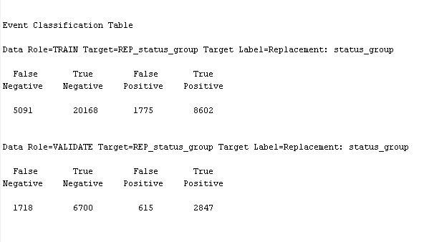
FORWARD LOGISTIC REGRESSION – CONT’D
CONFUSION MATRIX

Slide 17
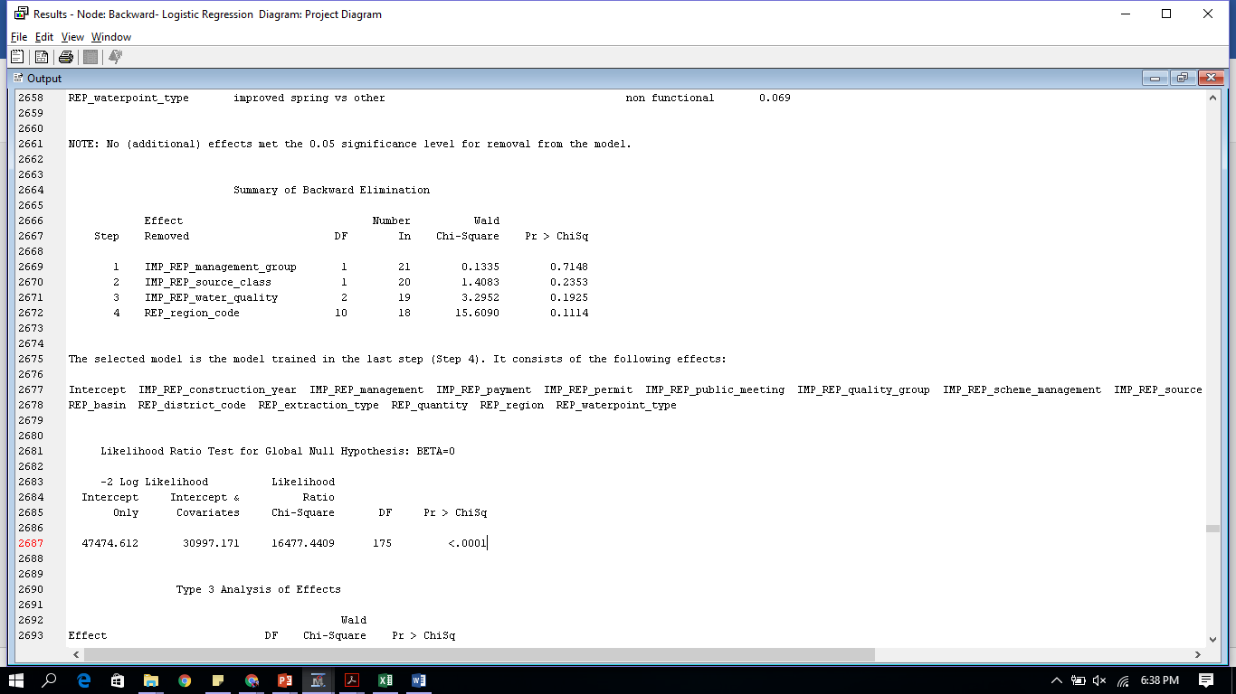
BACKWARD LOGISTIC REGRESSION
This technique starts from the full model, then effects are deleted one by one until a stopping condition is satisfied
A series of 4 steps are followed
The selected model is the model trained in the last step (step 4)
Misclassification rate is 0.1963

Slide 18
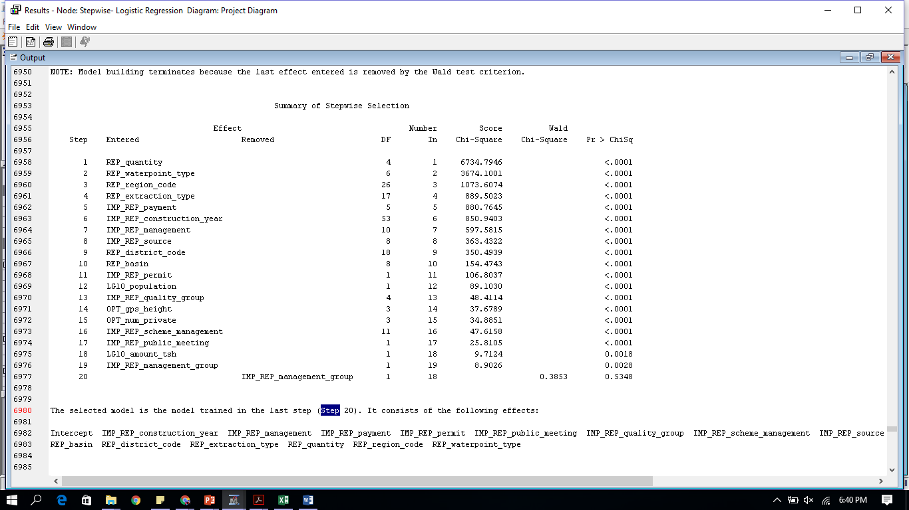
STEPWISE LOGISTIC REGRESSION
Builds a model by adding or removing variables based on test statistics
A series of 20 steps are followed
The selected model is the model trained in the last step (step 20)
Misclassification rate is 0.1963

Slide 19
NEURAL NETWORKS
Neural networks are a class of parametric models that can accommodate a wider variety of nonlinear relationships between a set of predictors and a target variable than can perform logistic regression.
The misclassification rate of this model is 0.1969.

Slide 20
DECISION TREES
Supervised learning method used for classification and regression
Goal - Create a model that predicts the target variable by learning simple decision rules inferred from the data features
Decision trees are produced by algorithms that identify various ways of splitting a dataset into branch-like segments
Simple and easy to use for Nominal (Binary) target variable
Types of Decision Trees used
2 Branch Decision tree
3 Branch Decision tree
Interactive Decision tree
Decision tree - variable selection

Slide 21
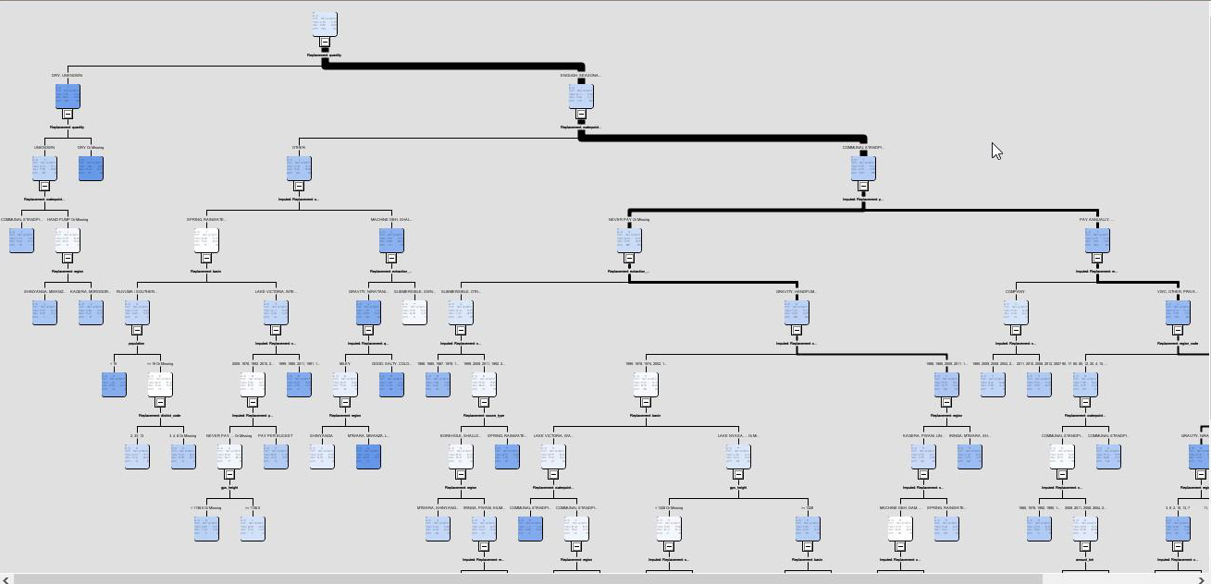
DECISION TREE 2 BRANCH
Misclassification Rate – 0.1911
No. of Leaf Nodes - 52

Slide 22
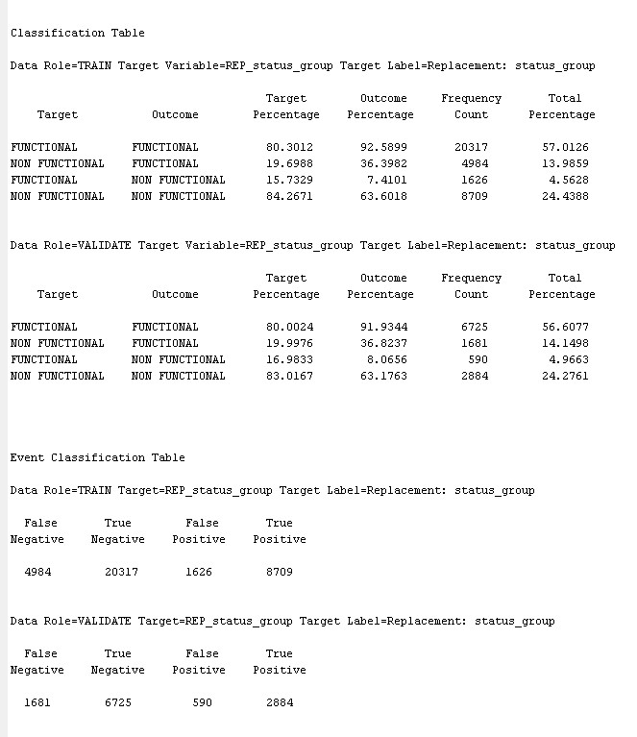
DECISION TREE 2 BRANCH – CONT’D

Slide 23
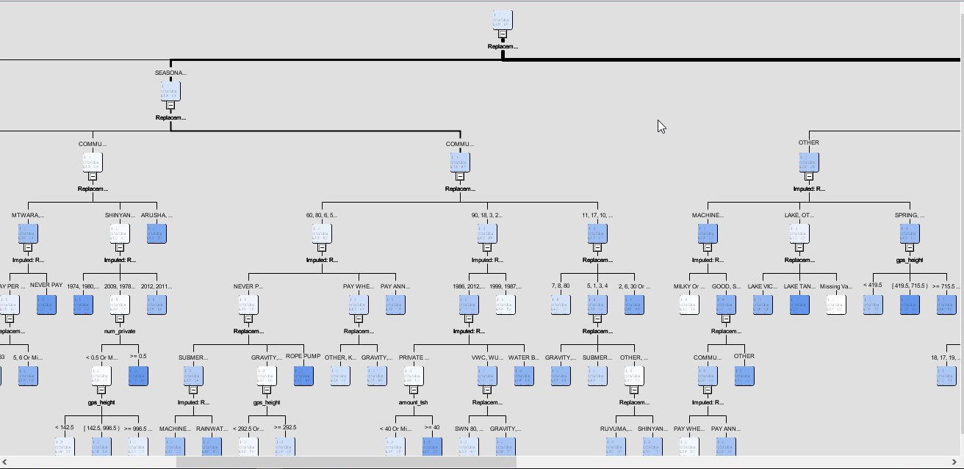
DECISION TREE 3 BRANCH
Misclassification Rate – 0.1876
No. of Leaf Nodes – 111

Slide 24
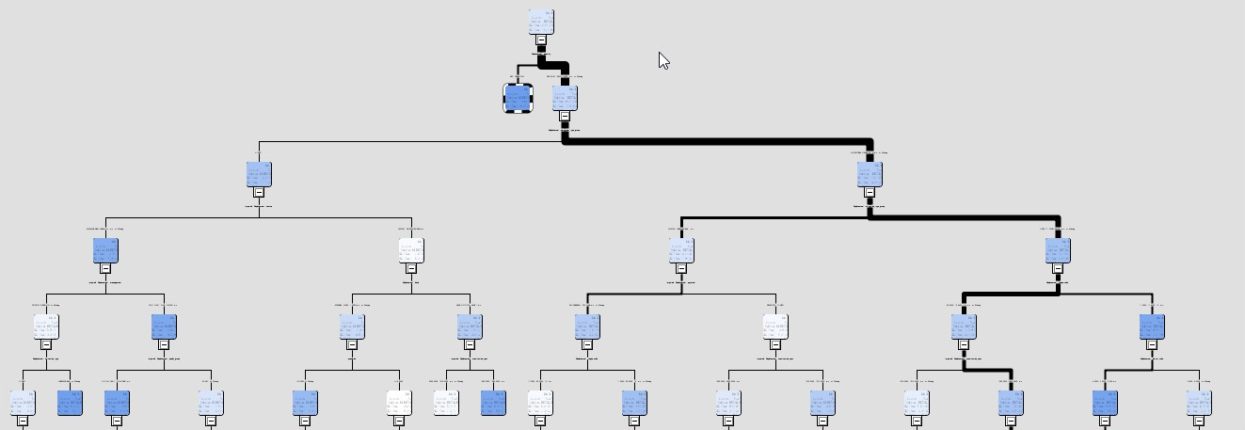
DECISION TREE INTERACTIVE
Misclassification Rate - 0.2123
No. of Leaf Nodes – 30

Slide 25
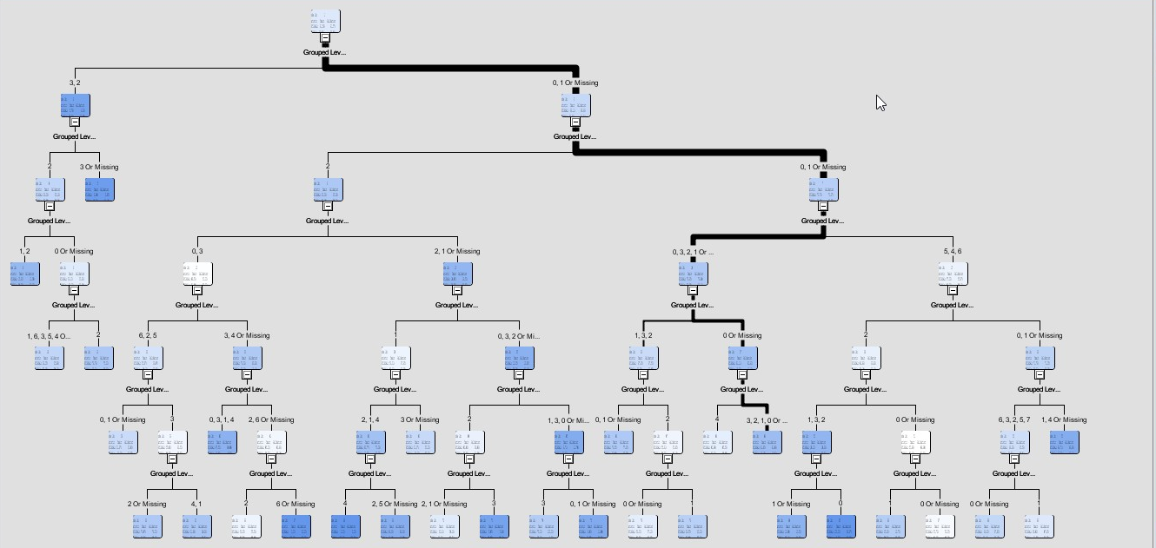
DECISION TREE -VARIABLE SELECTION
Misclassification Rate – 0.2129
No of Leaf Nodes – 29

Slide 26
GRADIENT BOOSTING
Decision Trees are used as weak learners in gradient boosting
Trees are built in greedy manner choosing the best split points to minimize the loss
Boosting is less prone to overfitting the data than a single tree

Slide 27
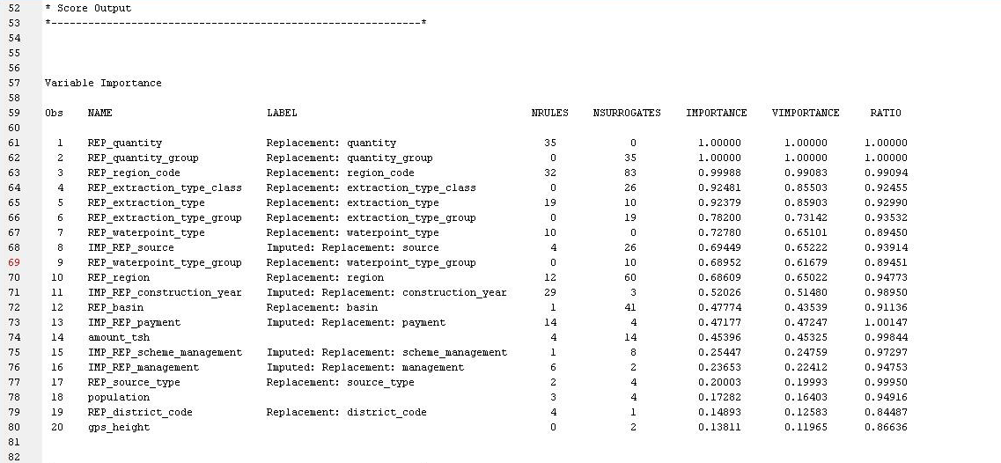
GRADIENT BOOSTING – CONT’D
Misclassification Rate – 0.2109

Slide 28
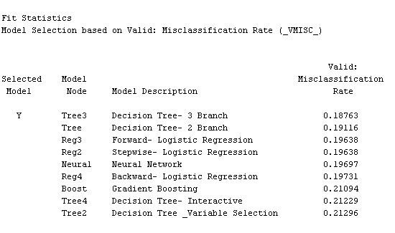
MODEL COMPARISON

Slide 29
MODEL COMPARISON – CONT’D

Slide 30
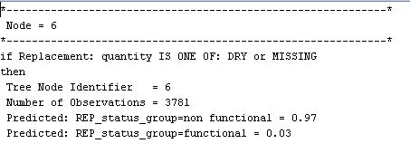
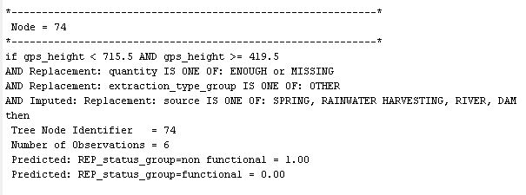
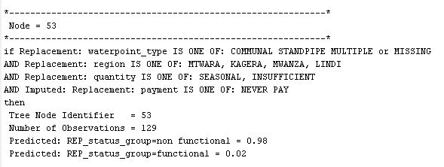
NODE RULES – 3 BRANCH

Slide 31
RECOMMENDATIONS
Statistically, pumps having any combination of these attributes have a higher chance of being non-functional
Concerned authorities and organizations should pay more attention in maintaining and improving the condition of these pumps
SOURCE | QUANTITY | QUALITY | MANAGEMENT | REGION
Dam | Dry | Fluoride | School | Mtwara
Spring | Enough |  | Water Board | Kagera
Hand DTW |  |  | Water Authority | Lindi
Shallow Well |  |  | WUA
Rain Water Harvesting

Slide 32
BUSINESS VALUE
Government of Tanzania can educate people on the location of functional pumps near them and use them to get water
Government authorities can identify dysfunctional pumps and take appropriate measures to repair them
Tanzanian Ministry of Water can understand the factors which cause a pump to fail and take suitable measures to reduce the number of non functional pumps
Welfare organizations can help in the maintenance of pumps
Data gathering efforts should be directed at predicting the time of failure of a pump so that proactive preventive action can be taken

Slide 33

THANK YOU!!

